Slide 1
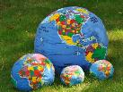
4/22/23 Earth Day & Water Day Mother Earth Concert Times Square - Announce 9/21/23, International Day of Peace
A
Good
News NonProfit Project
Achieving World Peace for the Children

Slide 2
EARTH DAY 4/22/2023 Times Square Broadcast Events TITLE, Peace, Love & Hope Presenter Level Benefits and Audience.
Good News Corporation, GNC, a 501 C 3 est. 2002 presents an invitation to become our TITLE Presenter or Peace/Love/Hope Level presenters for our Earth Day Broadcast Events. Water & Climate Change are one of the most important concerns for humankind’s survival
Our companies, Milestone Broadcast Corporation, est. 1985, along with GNC have helped many corporations increase awareness and create sales, i.e., Citibank, Delta, Sprint, Western Union, US Postal...leading ad agencies and more.
Once we discuss more specifics based on needs and targets…i.e., any CSR, ESG, DIVERSITY, EARTH/WATER /Climate RELATIONSHIP that you pursue, we will discuss how to build our Earth Day around the important work that you are already doing and support those that you do them with. Our desire is to meet and exceed your needs and targets.
WE ARE ALL ABOUT A WIN FOR YOU, WIN FOR US & WIN FOR THE
EARTH & WATER & PEOPLE, PLANTS & ANIMALS OF THE WORLD
GNC WILL CREATE 5 Hour LIVE Broadcast on Earth Day, April 22, 2023 in Times Square. Our broadcast partners UNIFY has 130 Million Reach Facebook Followers. These events strengthen the Good News, Positive Work, that is happening in the world for our Environment, JOIN US on on Earth Day April 22, 2023. WE ARE ALL IN THIS TOGETHER!

Slide 3
Title Presenter Broadcast Benefits -
The Title Presenter representative/s and suggested performer can speak/perform for 15 minutes at Water Day Press Conference & 45 minutes at Earth Day Concert
Title Presenter can insert a video/s into the events.
Public Relations/Program, Signage Soft Commercials/Sales - You will be included in all public relations, promotional materials, advertising and a publicity campaign. You can have signage on stage. As well name recognition and 2 minute commercial in all broadcasts/podcasts with your message at the beginning of the shows and at the end of the show. Title Funder will also will be mentioned and can show a commercial on each hour, aprox.,of the 5 hour broadcast.

Slide 4
Title Presenter Benefits – Page Two
Non-Profit Contribution: Title Earth and Water Presenter - One year exclusive package of recognition as the Title Presenter for the EARTH & WATER DAYS activities in Times Square, NY: Brought to you by: xxx Company/Foundation/Philanthropist. All funders will receive first refusal rights for 2024. Additionally, will have first right of refusal for our 9/21/23 International Day of Peace Times Square. Also we plan a Celebrity Concert on 9/21/23 at The Centennial Memorial Theater TBD. Total Exclusive Funder: Non-Profit Contribution: $125,000. Any additional contribution will be used for marketing.
First Right of Refusal & Non-profit Contribution

Slide 5
Peace Funder Benefits
World Water Day Virtual Press Conference Wednesday 3/22/23 - Speak for 7 minutes, including short video.
Earth Day Concert Times Square Saturday 4/22/23 - Speak/Suggested Talent/Video for 20 minutes
Public Relations/Program, Signage, Soft Commercials/Sales - Commercial 1 minute open/close. You can have signage on the side stations in Duffy Square. Mentioned each hour, aprox.,of the 5 hour broadcast.
Audience – All benefits, similar to Title Sponsor.
Non-Profit Contribution: Title Earth and Water Presenter - PEACE FUNDER funders will receive first refusal rights for 2024. Additionally, will have first right of refusal for our 9/21 International Day of Peace Times Square, Celebrity Concert at The Centennial Memorial Theater TBD. Total Exclusive Funder: Non-Profit Contribution: $50,000

Slide 6
Love Funder Benefits
World Water Day Times Square Press Conference Wednesday 3/22/23 - Speak for 4 minutes, including short video.
Earth Day Concert Times Square Saturday 4/22/23 - Speak/Suggested Talent/Video for 10 minutes
Public Relations/Program, Signage, Soft Commercials/Sales - Commercial 30 second minute open/close. You can have signage on the side stations in Duffy Square. Mentioned each hour, aprox.,of the 5 hour broadcast.
Audience – All benefits, similar to Title Sponsor.
Non-Profit Contribution: Title Earth and Water Presenter – LOVE FUNDER will receive first refusal rights for 2024. Additionally, will have first right of refusal for our 9/21 International Day of Peace Times Square, Celebrity Concert at The Centennial Memorial Theater TBD. Total Exclusive Funder: Non-Profit Contribution: $25,000

Slide 7
Hope Funder Benefits
World Water Day Times Square Press Conference Wednesday 3/22/23 - Speak for 2 minutes, including short video.
Earth Day Concert Times Square Saturday 4/22/23 - Speak/Suggested Talent/Video for 4 minutes
Public Relations/Program, Signage, Soft Commercials/Sales - Commercial 15 second minute open/close. You can have signage on the side stations in Duffy Square. Mentioned each hour, aprox.,of the 5 hour broadcast.
Audience – All benefits, similar to Title Sponsor.
Non-Profit Contribution: Title Earth and Water Presenter – HOPE FUNDER will receive first refusal rights for 2024. Additionally, will have first right of refusal for our 9/21 International Day of Peace Times Square, Celebrity Concert at The Centennial Memorial Theater TBD. Total Exclusive Funder: Non-Profit Contribution: $10,000

Slide 8
Audience
www.UNIFY.org will broadcast our event and has over 130 Million Viewers Reach on Facebook. UNIFY’S International Day of Peace some years ago, according to the UN received 2 Billion Views for Peace Day.
Weiwei, Chinese Superstar Broadcaster, 200 Million followers TBD
Good News Broadcast, est. 1998, receives aprox. 100,000 views per month on Youtube.com/Good News Broadcast. We have our Series, The Water Hour and 100’s of environment programs.
Social & Print Media – Good News has 30,000, we are in discussion with Tik Tok for their specific social outreach and some of the world’s largest Earth & Water Organizations to partner.
We will be giving the TV/Podcast shows to the world for free. Audience TBD The exact amount of viewers depends on who picks up the broadcast. A China Partner with 300 Million followers TBD
PBS - We plan to offer an edited program to PBS as well and our local community channels, just in NY, NY 300,000 households, but no commercials where we produce a show very often. We have the time already with our partner, WE.net. Speaking at our events is effective for PBS and non-commercial channels.
MetaVerse Groups state that they have Millions, and we are in discussions. TBD
The Presenting Funder’s social communities and websites, and marketing can utilize our logo, pr and video from the event.
Print readership from public relations TBD.
Times Square averages 400,000 people a day walking in the Square.

Slide 9
www.Pause the worldforpeace.org website

Slide 10
Good News Corporation & Partners Credentials & Recommendatons
Good News Corporation (GNC) - 501 C3 Nonprofit, est in 2002 The GNC mission is to find, receive & create TV/Radio/Podcast, Social Media, Print, Video Games and Events with Life Affirming, Thought provoking Non-Violent Good News Content. GNC has produced the International Day of Peace Concerts in Central Park, Times Square, Silicon Valley, Ca. since 2002. GNC partnered with UNIFY to Broadcast our Peace Day, UNIFY received over 2 Billion Views on Peace Day, they will broadcast 9/11, amongst others. We the World and their 11 Days of Global Unity are also partnering with us, est. 2002.
Production Partners of GNC are Milestone Broadcast Corporation, (MBC), Est. 1985, a full service multicultural marketing and production organization, client’s Citibank, IBM, Delta Airlines, Sprint, US Postal, Western Union. MBC has created over 6,000 Broadcasts on www.goodnewsbroadcast.com. Additional Production Partners is DPS & XStream who as worked in Times Square, Central Park/Great Lawn/NY, Madison Square Garden and additional prominent venues.
GNC has relationships with leading Public Relations Firms who will assist in promoting the events, GNC’s partner MBC has long-term relationships with the multicultural, niche and general worldwide as MBC represented many. Paul Sladkus, Founder of GNC & MBC: Former CBS/PBS Production Executive. Over 150 Network Emmy Winning TV Shows. (All In the Family, Sonny and Cher, Carol Burnett, and Love of Life, PBS Nature and Brain Series)

Slide 11
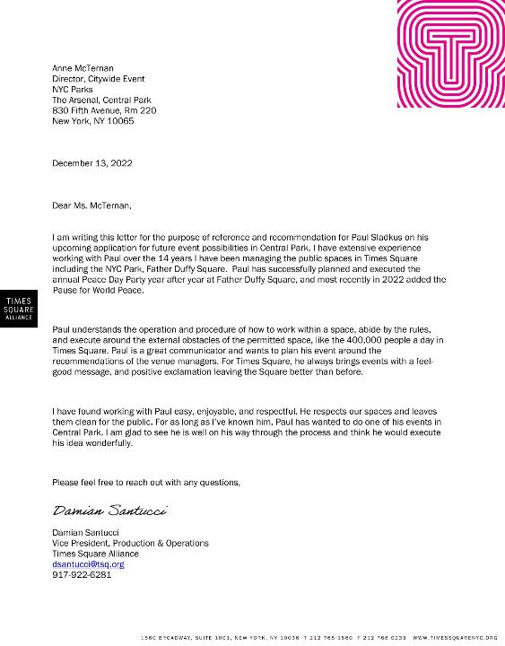

Slide 12
Paul understands the operation and procedure of how to work within a space, abide by the rules,
and execute around the external obstacles of the permitted space, like the 400,000 people a day in
Times Square. Paul is a great communicator and wants to plan his event around the
recommendations of the venue managers. For Times Square, he always brings events with a feelgood message, and positive exclamation leaving the Square better than before.
I have found working with Paul easy, enjoyable, and respectful.

Slide 13
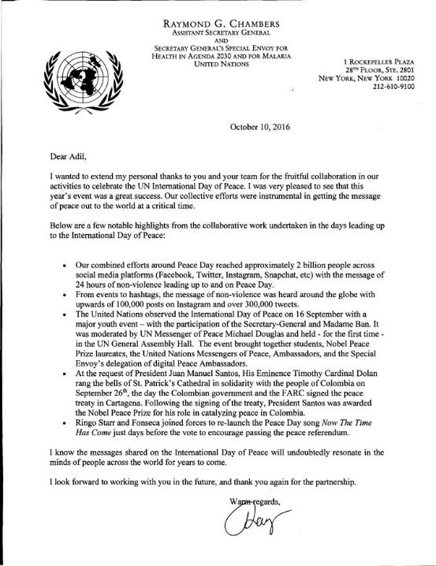

Slide 14
UNIFY Facebook Community 130+Million Followers as of 12/15/22

Slide 15
Next! Times Square International Day of Peace 9/21/23 & Celebrity Concert TBD
A
Good
News NonProfit Project
Achieving World Peace for the Children

